Slide 1

MLB THE SHOW DATABASE MANAGEMENT SYSTEM | Daniel Goetz and Joey Sabel IST 659 M004 Spring 2020

Slide 2
Content
Problem
Goals
Data Questions
Business Rules
Relational Data Model
Data Dictionaries
SQL Code
Interface Implementation - Forms and Reports

Slide 3
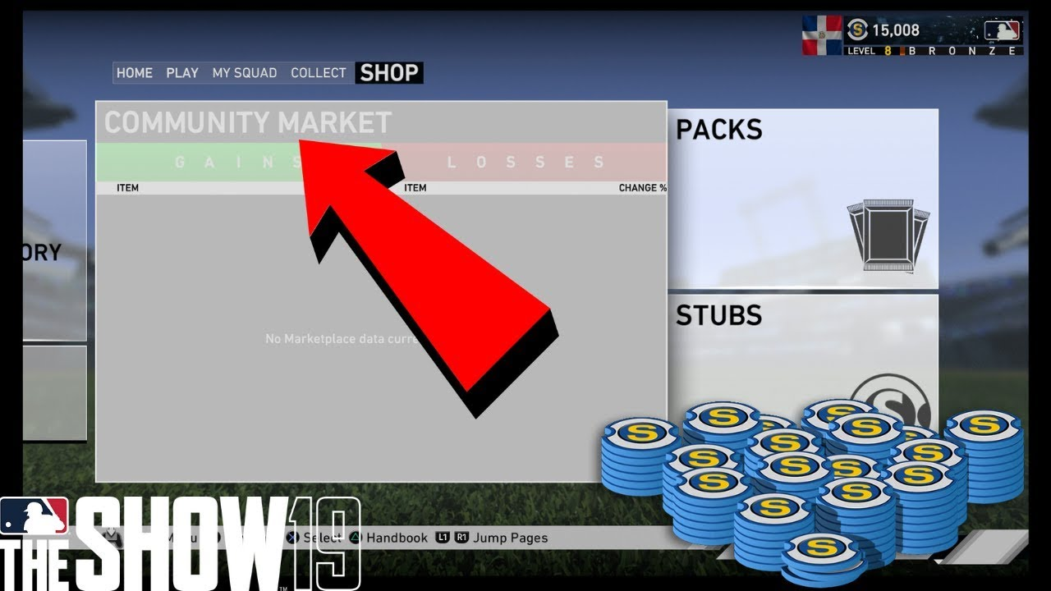
Background
In MLB The Show 20, there is a marketplace with real-time trading of cards using an in-game currency. However, there are many cards and it is hard to manage them if you try to collect all of them.

Slide 4
Problem
A recent trend in video games of all genres is a marketplace for items or cards in the game, which can be purchased with an in-game economy and/or money from the real world
Some of these games have an expansive number of items making it hard to keep track of which things are important and how much they cost in in-game currency

Slide 5
Goals
We are trying to solve the issue of having a difficult to navigate market in MLB The Show 20.
To create a easy to use database for players of the game to easily find or add cards.
We want our users to see how much USD each card would cost them if they were to purchase in game currency and how much they would have to sell a card for to make their money back.

Slide 6
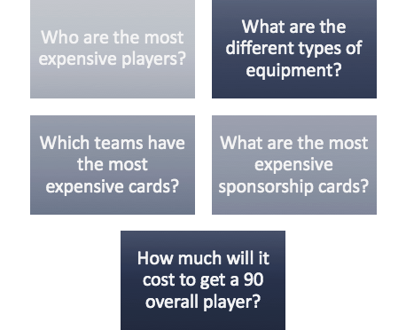
Major Data Questions
During the course of the creation of the database, we attempted to answer these five questions

Slide 7
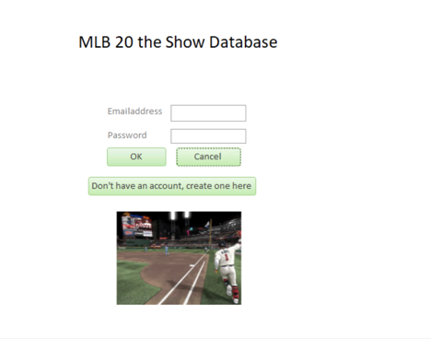
Introduction to our MLB 20 The Show Database System

Slide 8
Business Rules
1. Users can only search for one card at a time.
2. All data comes directly from MLB The Show unless otherwise noted.
3. Users can not directly make money directly off of our database.
4. Users can not share our information with any other website or source.
5. We will protect user information in their accounts so that only they can access it.
6. All user data will not be shared with any other website or source.
7. Each user must enter a UserID (email address) everytime they use our database.
8. All data provided will be as accurate as available.
9. We will take user feedback into consideration for improvements.
10. Users can not delete data from the database

Slide 9
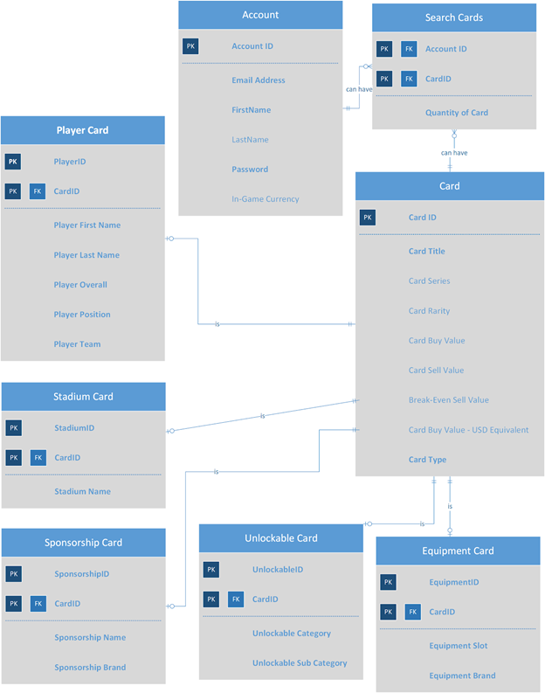

ERD

Slide 10
Account
Entity Name: Account | Entry and Attributes | Field Type | Nullable | Foreign Key Constraints | Description
Primary Key | AccountID | CHAR(10) | NOT NULL |  | Unique ID for each account
 | AccountEmail | VARCHAR(30) | NOT NULL |  | Email address of user
 | AccountFirstName | VARCHAR(20) | NOT NULL |  | First name of user
 | AccountLastName | VARCHAR(20) | NULL |  | Last name of user
 | AccountPassword | VARCHAR(20) | NOT NULL |  | Password used for account
 | AccountCurrency | INT | NULL |  | Amount of virtual currency the account has in the MLB 20 The Show

Slide 11
Card
Entity Name: Card | Entry and Attributes | Field Type | Nullable | Foreign Key Constraints | Description
Primary Key | CardID | CHAR(10) | NOT NULL |  | Unique ID for each card
 | CardTitle | VARCHAR(30) | NOT NULL |  | Name for each card
 | CardSeries | VARCHAR(20) | NULL |  | Series for each card (if applicable)
 | CardRarity | VARCHAR(20) | NULL |  | Rarity of each card (if applicable)
 | CardBuyValue | INT | NULL |  | Minimum value to buy card on market to guarantee immediate sale
 | CardSellValue | INT | NULL |  | Maximum value to sell card on market to guarantee immediate sale
 | BreakEvenSellValue | INT | NULL |  | Amount card would need to be sold for to break even based on current Buy Now value
 | USDDollarEQ | FLOAT | NULL |  | US dollar equivalent of Buy Now value based on 24,000 of in game currency per $20
 | CardType | VARCHAR(12) | NOT NULL |  | Type of card: Player, sponsorship, unlockable, etc.

Slide 12
Search Card
Entity Name: Search | Entry and Attributes | Field Type | Nullable | Foreign Key Constraints | Description
Primary Key Foreign Key 1 | AccountID | CHAR(10) | NOT NULL | Table Account (AccountID) | Unique ID for each account
Primary Key Foreign Key 2 | CardID | CHAR(10) | NOT NULL | Table Card (CardID) | Name for each card
 | QuantityOfCard | INT | NULL |  | Number of each card (if applicable)

Slide 13
Player Card
Entity Name: Player | Entry and Attributes | Field Type | Nullable | Foreign Key Constraints | Description
Primary Key | PlayerID | CHAR(10) | NOT NULL |  | Unique ID for each player card
Primary Key Foreign Key | CardID | CHAR(10) | NOT NULL | Table Card (CardID) | Unique ID for each card
 | PlayerFirstName | VARCHAR(30) | NOT NULL |  | First Name of the Player
 | PlayerLastName | VARCHAR(30) | NOT NULL |  | Last Name of the Player
 | PlayerOverall | INT | NOT NULL |  | Player overall
 | PlayerPosition | VARCHAR(20) | NOT NULL |  | Position each player plays
 | PlayerTeam | VARCHAR(20) | NOT NULL |  | Team player plays on

Slide 14
Stadium
Entity Name: Stadium | Entry and Attributes | Field Type | Nullable | Foreign Key Constraints | Description
Primary Key Foreign Key 1 | CardID | CHAR(10) | NOT NULL | Table Card (CardID) | Unique ID for each card
Primary Key | StadiumID | CHAR(10) | NOT NULL |  | UniqueID for each stadium
 | StadiumName | VARCHAR(30) | NOT NULL |  | The actual name for each stadium

Slide 15
Unlockable
Entity Name: Unlockable | Entry and Attributes | Field Type | Nullable | Foreign Key Constraints | Description
Primary Key | UnlockableID | CHAR(10) | NOT NULL |  | Unique ID for each unlockable
Primary Key Foreign Key 1 | CardID | CHAR(10) | NOT NULL | Table Card (CardID) | Unique ID for each card
 | Unlockable Category | VARCHAR(20) | NOT NULL |  | Category for each card
 | Unlockable Sub Category | VARCHAR(20) | NOT NULL |  | Sub category for each card

Slide 16
Equipment
Entity Name: Equipment | Entry and Attributes | Field Type | Nullable | Foreign Key Constraints | Description
Primary Key Foreign Key 1 | CardID | CHAR(10) | NOT NULL | Table Card (Card ID) | Unique ID for each card
Primary Key | EquipmentID | CHAR(10)) | NOT NULL |  | Unique ID for each equipment card
 | EquipmentSlot | VARCHAR(20) | NOT NULL |  | Type of equipment (glove, shoes, etc.)
 | EquipmentBrand | VARCHAR(20) | NOT NULL |  | Brand of each equipment (Adidas,Mizuno)

Slide 17
Code
--create table Player
CREATE TABLE Player(
PlayerID CHAR(10) NOT NULL
,CardID CHAR(10) NOT NULL
,FirstName VARCHAR(10) NOT NULL
,LastName VARCHAR(50) NOT NULL
,Overall INTEGER NOT NULL
,Pos VARCHAR(20) NOT NULL
,Team VARCHAR(20) NOT NULL,
constraint player_pk1 primary key (PlayerID,CardID),
constraint player_fk1 foreign key (CardID) references Cards(CardID)
);
--populate table Player
Note: We inserted more players than shown but this is just a sample.
INSERT INTO Player(PlayerID,CardID,FirstName,LastName,Overall,Pos,Team) VALUES (1,11216,'Mike','Trout',95,'CF','Angels');
INSERT INTO Player(PlayerID,CardID,FirstName,LastName,Overall,Pos,Team) VALUES (2,96979,'Miguel','Cabrera',94,'3B','Tigers');
INSERT INTO Player(PlayerID,CardID,FirstName,LastName,Overall,Pos,Team) VALUES (3,79922,'Vida','Blue',93,'SP','Athletics');
INSERT INTO Player(PlayerID,CardID,FirstName,LastName,Overall,Pos,Team) VALUES (4,1,'Roy','Oswalt',93,'SP','Astros');
INSERT INTO Player(PlayerID,CardID,FirstName,LastName,Overall,Pos,Team) VALUES (5,41929,'Joe','Carter',93,'RF','Blue Jays');
INSERT INTO Player(PlayerID,CardID,FirstName,LastName,Overall,Pos,Team) VALUES (6,61287,'Bob','Feller',93,'SP','Indians');

Slide 18

Interface Implementation

Slide 19
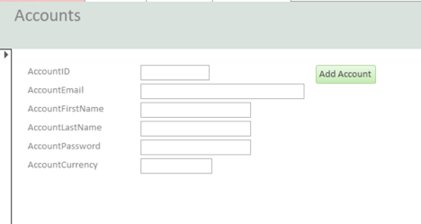

Slide 20
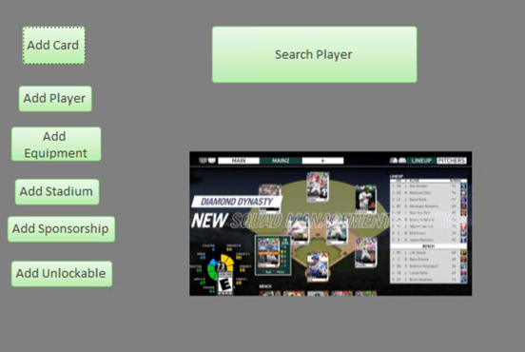
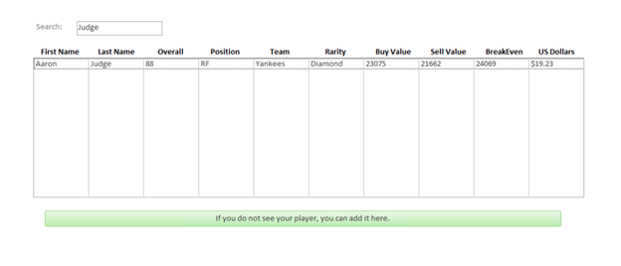
Forms

Slide 21
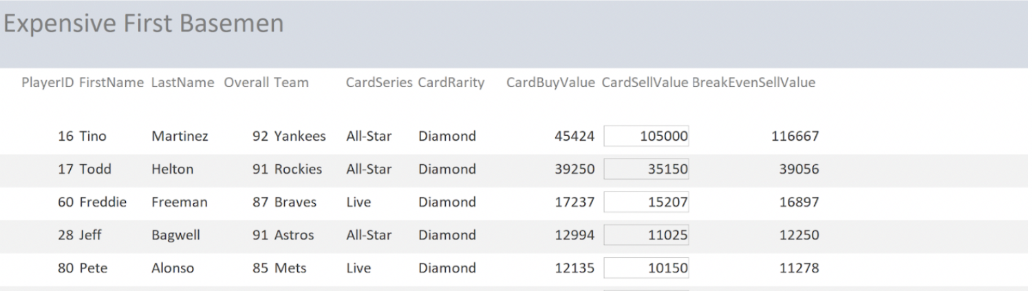
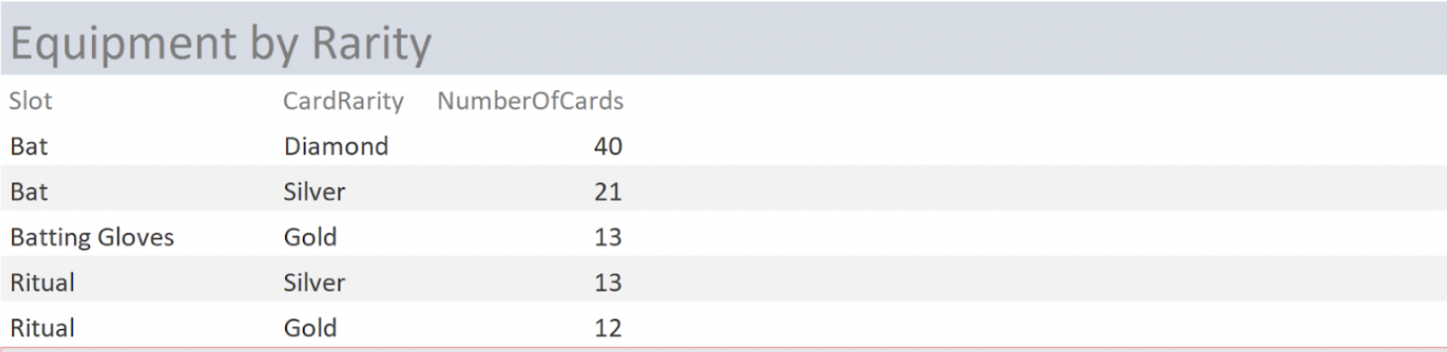
Reports

Slide 22
Examples

Slide 23
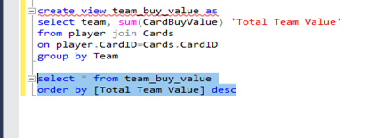
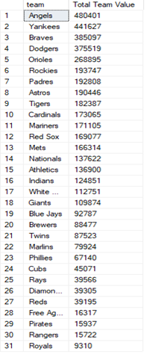
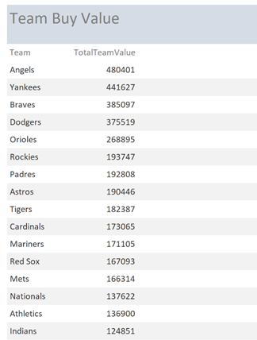
Reports - Answering Major Data Questions
What team has the most expensive cards?

Slide 24
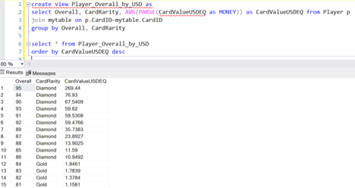
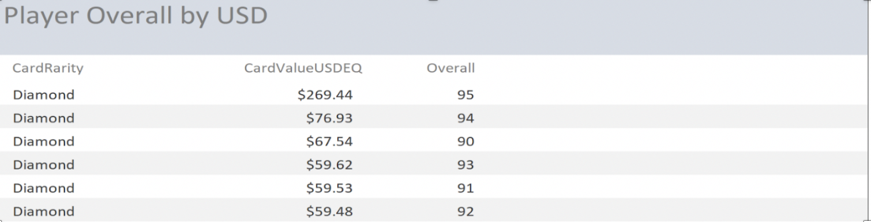
Reports - Answering Major Data Questions
How much will it cost me to get a 90 overall player?

Slide 25
Our Plans for the Future
Create forms to add other cards
Add a search table for all other cards.
Create RStudio implementation to update cards automatically
Take user feedback to make improvements

Slide 26
Thank You

